Slide 1
Tree Searches
Depth-First Search

Slide 2
Tree Searches
A tree search starts at the root and explores nodes from there, looking for a goal node (a node that satisfies certain conditions, depending on the problem)

Slide 3
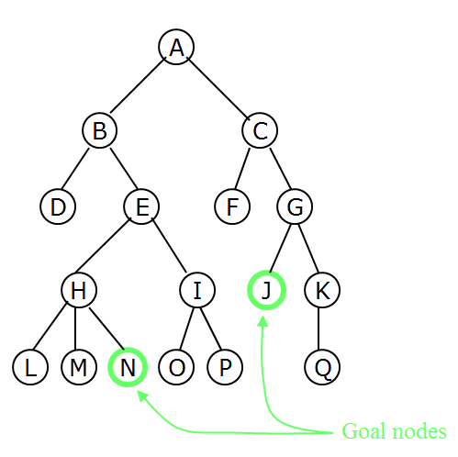
Tree Searches
For some problems, any goal node is acceptable (N or J); for other problems, you want a minimum-depth goal node, that is, a goal node nearest the root (only J)

Slide 4
Depth-First Search
Depth First Search
Starting at some vertex, we process the current vertex and then recursively traverse the first vertices adjacent to it.(backtrack if necessary)
If this is done on a tree O(|E|)
If this is done on a graph with cycles we need to avoid going in the cycle forever.

Slide 5
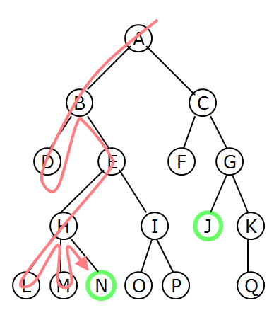
Depth-First Searching
A depth-first search (DFS) explores a path all the way to a leaf before backtracking and exploring another path
For example, after searching A, then B, then D, the search backtracks and tries another path from B
Node are explored in the order A B D E H L M N I O P C F G J K Q
N will be found before J

Slide 6
DFS Code and Discussion
void Graph::dfs(Vertex v)
{
v.visited = true;
for each w adjacent to v
if (!w.visited)
dfs(w);
}
Each vertex initialized visited to false
As visit it, change visited to true
Visit each vertex once, and possibly try every edge O(|E| + |V|)

Slide 7
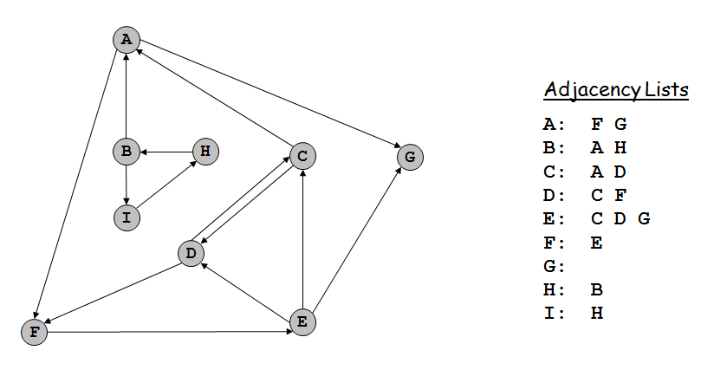
Directed Depth First Search

Slide 8
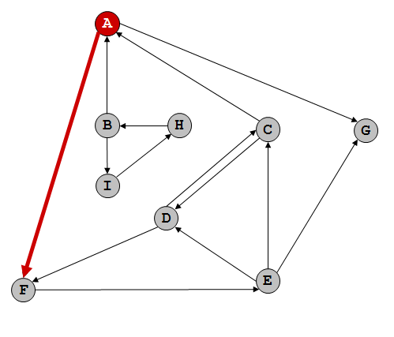
Directed Depth First Search
dfs(A) A-F A-G (use alphabet order for ties)
Function call stack: dfs(A)

Slide 9
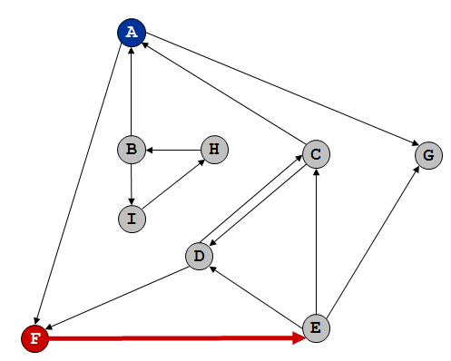
Directed Depth First Search
dfs(F) F-E
Function call stack: dfs(A) dfs(F)

Slide 10
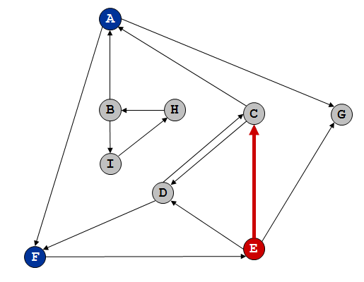
Directed Depth First Search
dfs(E) E-C E-D E-G – visit C
Function call stack: dfs(A) dfs(F) dfs(E)

Slide 11
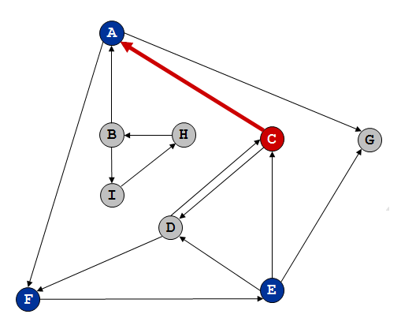
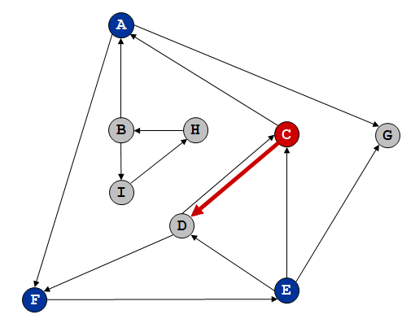
Directed Depth First Search
dfs(C) C-A C-D – A already visited
C-A C-D – visit D
Function call stack: dfs(A) dfs(F) dfs(E) dfs(C)

Slide 12
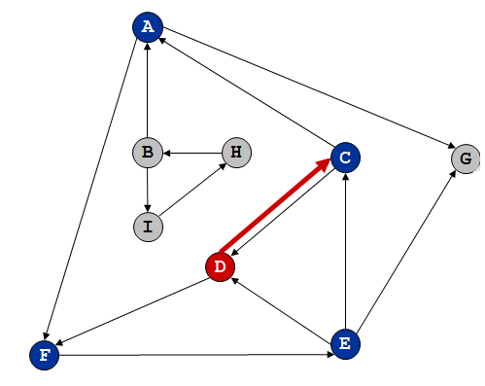
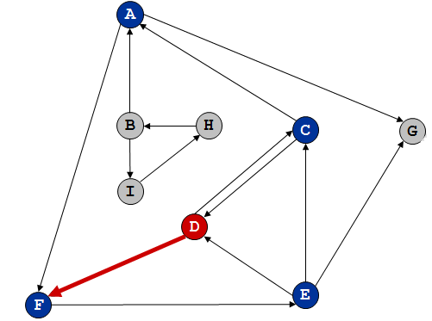
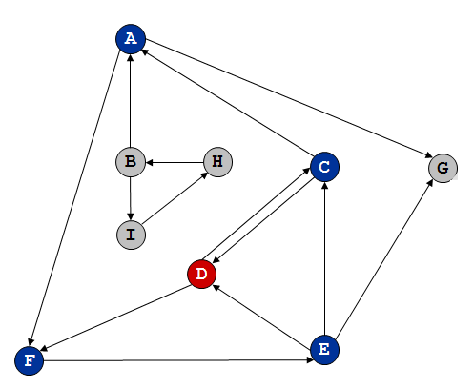
Directed Depth First Search
dfs(D) D-C D-F – C already visited
D-C D-F – F already visited
no more paths, backtrack to C
Function call stack: dfs(A) dfs(F) dfs(E) dfs(C) dfs(D)

Slide 13
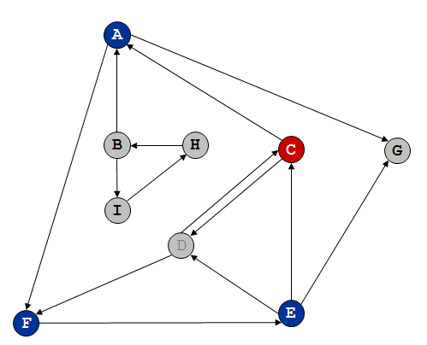
Directed Depth First Search
dfs(C) C-A C-D – A already visited previously
C-A C-D – D already visited
no more paths, backtrack to E
Function call stack: dfs(A) dfs(F) dfs(E) dfs(C)

Slide 14
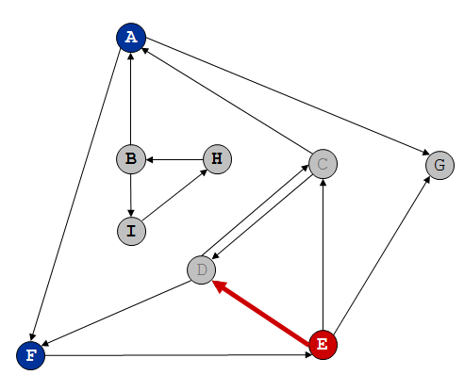
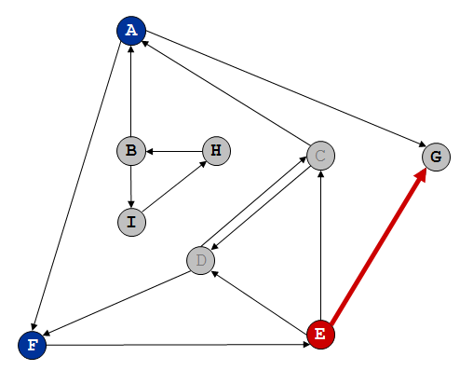
Directed Depth First Search
dfs(E) E-C E-D E-G – C already visited previously
E-C E-D E-G – D already visited
E-C E-D E-G – visit G
Function call stack: dfs(A) dfs(F) dfs(E)

Slide 15
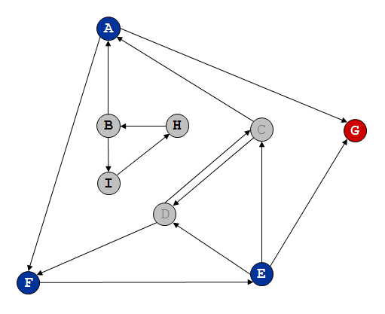
Directed Depth First Search
dfs(G) no paths from G
Backtrack to E
Function call stack: dfs(A) dfs(F) dfs(E) dfs(G)

Slide 16
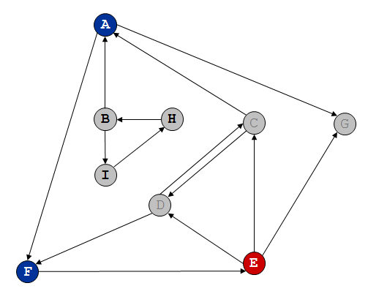
Directed Depth First Search
No paths from G
Backtrack to E
Function call stack: dfs(A) dfs(F) dfs(E)

Slide 17
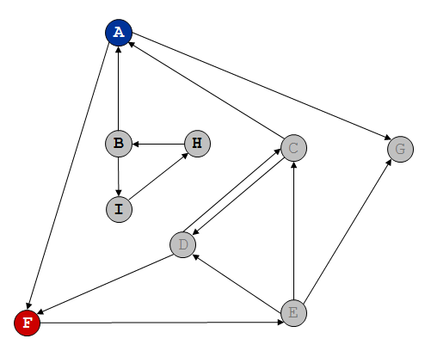
Directed Depth First Search
dfs(E) E-C E-D E-G – C already visited previously
E-C E-D E-G – D already visited
E-C E-D E-G – G already visited
Backtrack to F
Function call stack: dfs(A) dfs(F)

Slide 18
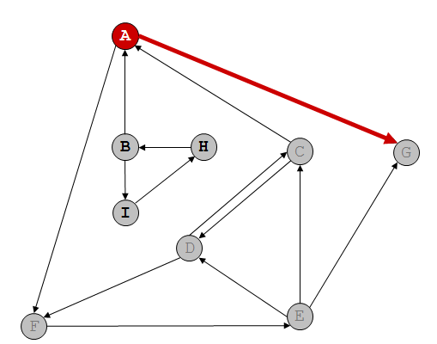
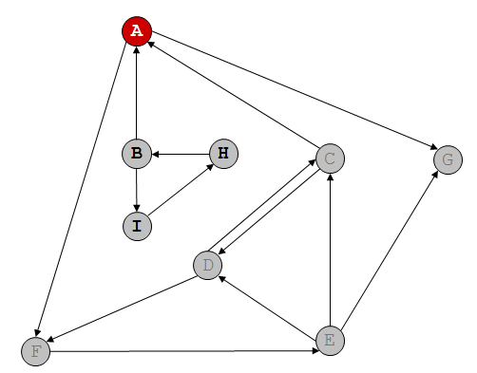
Directed Depth First Search
No more paths from F
Backtrack to A
dfs(A) A-F A-G – F visited
A-F A-G – G visited
no more paths
Function call stack: dfs(A)

Slide 19
Directed Depth First Search
No more bactracking
DFS from A – A, F, E, C, D, G
Cannot reach B, I, H from A

